Slide 1
Design and Analysis of Algorithms
F.Y.MCA SEM II AY 2024-25

Slide 2
Design and Analysis of Algorithms
Course Outcomes
MC507.1 | Analyze time and space complexity of different algorithms
MC507.2 | Analyze various divide & conquer algorithms
MC507.3 | Apply greedy and dynamic method to given problem
MC507.4 | Make use of backtracking, branch and bound techniques, graphs to solve a problem

Slide 3
1 Fundamentals of Algorithmic Problem Solving and Efficiency
The Role of Algorithms in Computing
Substitution Method
Master Method
Recursion Tree Method
Time complexity - Worst case,Best case and Average case analysis
Space complexity
Asymptotic notations (Big O, Omega , Theta)

Slide 4
Example
A simple algorithm for finding the largest number in an array:
Input: An array of numbers [2,5,8,1,3]
Algorithm:
Initialize a variable max to the first element of the array.
Iterate through each element in the array.
If the current element is greater than max, update max to the current element.
After iterating through the array, return the value of max.
Output: The largest number in the array is 8

Slide 5
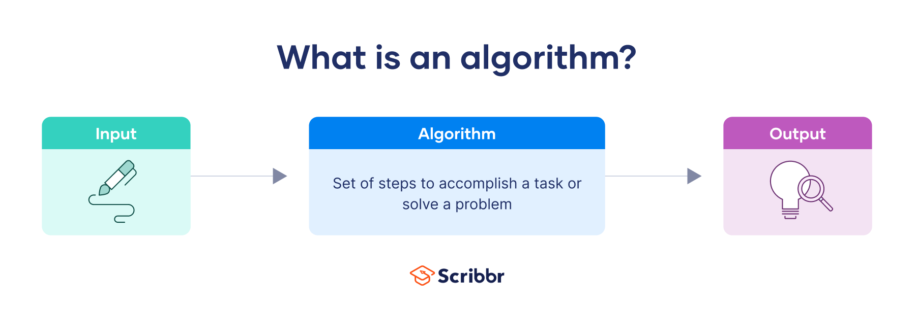
Algorithms
An algorithm is a repeatable process for determining the solution to a problem.
A well-defined computational procedure that takes a set of value(s), as input and produces a set of value(s), as output.
A tool for solving a well-specified computational problem (problem statement).
The problem statement specifies, the desired input/output relationship, in general terms.

Slide 6
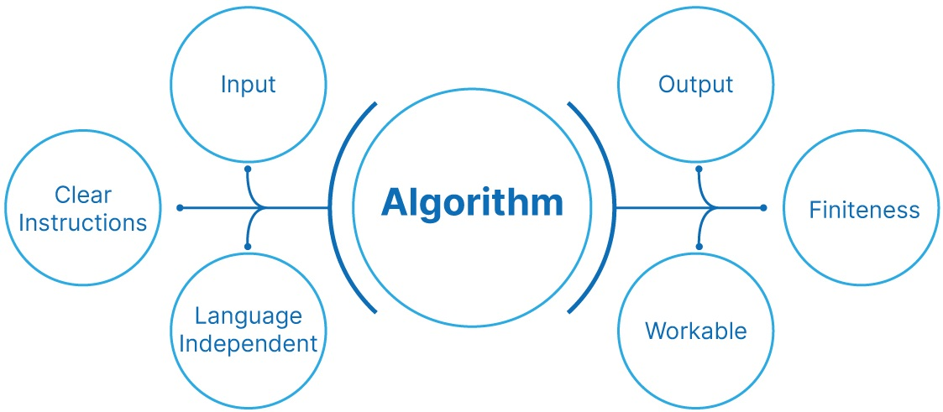
An algorithm refers to a series of step-by-step procedures or a collection of guidelines or rules to follow in order to complete a specific task or solve a specific problem.

Slide 7
Algorithms can be written in plain simple English language so that it is easily understandable even by non-programmers. And algorithms are programming languages independent in nature.
Input: An algorithm must have an input, and that input should not be zero (0).
Output: At the end, you must receive at least one output.
Clear instructions: An algorithm must have thorough and clear instructions.
Finiteness: An algorithm must consist of a finite number of steps, i.e., it must be finite and should terminate.
Workable: The algorithms must be simple and straightforward and should not include any future technology or anything else. It should be executable with the available resources.
Language independent: Algorithms should not be dependent on any programming language. In simple terms, you should receive the same output, even after running on different programming languages.

Slide 8
Do we use Algorithms daily?
Find a cereal in the grocery store.
Re-organizing your closet to make finding stuff easier.
Finding something good to watch on TV.
Going College from Home or Vice versa .
Studying for exam last moment.

Slide 9
Growth of Functions
Function - f(x) ; for every f(x) an output is generated with some input value.
The growth of functions in Design Analysis of Algorithms refers to how the running time or space usage of an algorithm grows relative to the size of its input. This is crucial because it helps us understand the efficiency of algorithms, especially for large inputs.
For example:
If it takes 2 seconds to search 10 items, how long will it take for 100 items?
That depends on the algorithm used. The "growth" tells us this relationship.

Slide 10
Asymptotic Notation
1.It is mathematical notation that describes how long an algorithm takes to run a given
input.
2.To describe how long it will take an algorithm (a step-by-step process) to solve a problem
as the size of the input increases. Big O notation helps us do that in a general way,
without needing to know the exact time it will take. We care more about how the time or
space grows as the input gets bigger.
3. Imagine you're hosting a party, and the task is to greet every guest at the door.
If the number of guests increases, how much time you spend greeting them ?
"As the number of guests increases, I’ll need more time—but exactly how much more time?"

Slide 11
Asymptotic Notation
Big O (O-notation): Worst-case performance
Big O describes the upper bound of an algorithm's running time or space requirements in the worst-case scenario.
It tells you how the time or space grows as the input size increases, but only in the worst case.
Big Omega (Ω-notation): Best-case performance
Big Omega describes the lower bound of an algorithm’s running time or space requirements in the best-case scenario.
It tells you the minimum amount of time or space the algorithm will need for any input of size n.
Big Theta (Θ-notation): Tight bound (Exact)
Big Theta describes the exact or tight bound of an algorithm’s performance. It tells you both the upper and lower bounds for the algorithm’s running time or space usage.

Slide 12
Big-O Notation (O-notation)
O-notation - This is a way to describe how fast the function grows.
1.O(1): Constant Time
The running time doesn’t change with the input size.
Suppose you have many guest to attend for a party.
Checking if the first guest is wearing a red shirt. Whether you have 1 guest or 100 guests, it’s still just 1 action.
Example: Checking if a number is even or odd
O(1) means no matter how big the input is, the algorithm takes the same amount of time.

Slide 13
Big-O Notation (O-notation)
2. O(n) - Linear Time
The time increases in direct proportion to the number of guests. If you take 1 second to greet each guest, 100 guests will take 100 seconds.
Greeting each guest at the door one by one. The more guests, the longer it takes, but the time grows at a predictable rate.
O(n) means the time grows directly with the number of guests (n).
Example: Linear search in an unsorted list.

Slide 14
Big-O Notation (O-notation)
3.O(log n): Logarithmic Time The running time increases slowly as input size grows.Efficient for large inputs.
The time doesn’t grow linearly. Instead, as the number of guests increases, the time grows much slower. It’s like cutting the problem in half repeatedly.
Suppose you have a list of guests sorted by name, and you use a clever method (binary search) to find a specific guest. With each step, you can narrow down the list by half, so the time grows much slower.
O(log n) means that as the number of guests increases, the time grows very slowly. Doubling the number of guests doesn’t double the time—it increases just a little bit.
Example: Binary search in a sorted list.

Slide 15
Big-O Notation (O-notation)
4.O(n²) - Quadratic Time
The time grows much faster as the number of guests increases. If there are 10 guests, it might take 100 seconds (10 × 10). If there are 100 guests, it could take 10,000 seconds.
Imagine you greet each guest, then each guest shakes hands with every other guest (you greet guest 1, guest 2 shakes hands with guest 1, guest 3 shakes hands with guest 1, etc.).
O(n²) means that if the number of guests doubles, the time required quadruples!
Example: Bubble sort, comparing every pair of items.,Becomes impractical for large inputs.

Slide 16
Big-O Notation (O-notation)
5.O(2ⁿ): Exponential Time
Running time doubles with every additional input element.
Example: Solving the Traveling Salesman Problem using brute force.,Grows very fast, impractical for large inputs.
6.O(n!): Factorial Time
Extremely fast-growing; almost always impractical.
Example: Generating all permutations of a list.

Slide 17
Comparison of Big O, Big Omega, and Big Theta
Big O (O): Upper bound (worst-case scenario). It tells you the maximum time or space the algorithm could take.
Example: O(n) — The algorithm will take at most n time.
Big Omega (Ω): Lower bound (best-case scenario). It tells you the minimum time or space the algorithm will take.
Example: Ω(n) — The algorithm will take at least n time.
Big Theta (Θ): Exact bound (tight bound). It tells you the exact time or space the algorithm will take, providing both the upper and lower bounds.
Example: Θ(n) — The algorithm will always take n time (both in best-case and worst-case).

Slide 18
Growth of functions describes how algorithms behave as input grows.
n | O(1) | O(log n) | O(n) | O(n log n) | O(n²) | O(2ⁿ)
1 | 1 | 0 | 1 | 0 | 1 | 2
2 | 1 | 1 | 2 | 2 | 4 | 4
3 | 1 | 1 | 3 | 3 | 9 | 8
4 | 1 | 1 | 4 | 8 | 16 | 16
5 | 1 | 1 | 5 | 11 | 25 | 32
6 | 1 | 1 | 6 | 15 | 36 | 64
7 | 1 | 1 | 7 | 19 | 49 | 128
8 | 1 | 2 | 8 | 24 | 64 | 256
9 | 1 | 2 | 9 | 28 | 81 | 512
10 | 1 | 2 | 10 | 33 | 100 | 1024
100 | 1 | 4 | 100 | 2656 | 10000 | 1.26E+30

Slide 19
Time Complexity and Space Complexity
Designing algorithms is about making decisions and decisions have
trade offs. You might want to optimize to complete the task:
in the shortest time
using the least amount of space
This where complexity comes in, where you want to answer the following questions:
How do you know if your algorithm is good?
How do you compare algorithms?
So we can break this down to two concepts:
Time Complexity -> How long does the algorithm take
Space Complexity -> How much space does the algorithm use
The less complex we make the algorithm the better.

Slide 20
SPACE COMPLEXITY DEFINITION
Space complexity is a measure of the amount of memory an algorithm uses, expressed in terms of the size of the input.
It refers to the amount of memory storage required to execute the algorithm and solve a problem.
A low space complexity means that an algorithm requires relatively little memory to solve the problem, while a high space complexity means that it requires a large amount of memory, potentially leading to slow performance or memory limitations.

Slide 21
Why do we need to Calculate Space Complexity?
To ensure the efficiency and effectiveness of an algorithm or problem, it is necessary to calculate its space complexity.
Despite the fact that modern systems usually have ample memory, analyzing the space complexity is still important to optimize the algorithm and make it run with a minimal amount of memory.
This is particularly important for real-world applications, where developers must consider the memory limitations of the systems they are using and avoid processes that use more memory than is available.
By considering the space complexity, developers can make informed decisions about which data structures and algorithms to use, and can ensure that their applications run smoothly and efficiently.

Slide 22
How to Calculate Space Complexity?
Evaluating the space complexity of an algorithm involves determining the amount of memory used by various elements such as variables of different data types, program instructions, constant values, and in some cases, function calls and the recursion stack.
The exact amount of memory used by different data types may vary depending on the operating system, but the method of calculating the space complexity remains constant.
To determine the space-complexity, it is important to consider all of these factors and to add up the memory used by each element to get an overall measure of the algorithm’s memory usage.

Slide 23
Data Type | Memory Space (in bytes)
int | 4
float | 4
double | 8
char | 1
short int | 2
long int | 4

Slide 24
Space complexity Example 1
Algorithm for sum of Two Numbers
sum(p,q,r)
{
p=1;
q=2;
r=p+q;
}
p - constant - 1 unit
q - constant - 1 unit
r- constant - 1 unit
S(P) = C + Sp
= 1+1+1 +0
= 3 =1
O(1)

Slide 25
Space complexity Example 2
Int square (int a)
{
return a* a
}
Fixed amount of space for all input values if a= 1,a=2,....n
S(P) = C + Sp
= 1 + Sp
= 1
O(1)
int main
{
Int a = 10 ;
Float b = 20.5;
Char c = ‘A’;
int d [10];
Return 0;
}

Slide 26
Space complexity Example 3
int main
{
Int a = 10 ;--------------------------- 1 unit (4 bytes)
Float b = 20.5;-----------------------1 unit (4 bytes)
Char c = ‘A’;--------------------------1 unit (1 byte)
int d [10];------------------------------10*4
Return 0;
}
Total memory usage
= 4+4+1+10*4
= 49 bytes
S(P) = 1+1+1+1+0
= 4 =1
O(1)

Slide 27
Space complexity Example 4
Int main()
{
Double x = 15.75 ;
Char y = ‘B’;
Int z [ 20];
}
Total memory usage ?
Complexity in terms of Big O ?
Total memory usage = 8 + 1+ 20*4
= 89 bytes
S(P) = 1+1+1 + 0
= 3 =1
O(1)

Slide 28
Space complexity example 5
Sum (si n)
{ total = 0;
For i =0 to n do;
total = total + s[i]; }
total - 1 unit
i-1 unit
n-1 unit
s- n units
S(P) = C + S(p)
= 1+1+1 + n
= 3 + n
Consider only highest power , here its n .
O(n)

Slide 29
Space Complexity Table for Common Algorithms
Algorithm | Space Complexity
Linear Search | O(1)
Binary Search | O(1)
Bubble Sort | O(1)
Insertion Sort | O(1)
Selection Sort | O(1)
Quick Sort | O(log n)
Merge Sort | O(n)
Depth First Search (DFS) | O(n)
Breadth First Search (BFS) | O(n)
Dynamic Programming | O(n^2) or O(n*m)
Greedy Algorithm | O(n)
Backtracking | O(2^n)

Slide 30
Time Complexity
Time complexity of an algorithm signifies the total time required by the program to run till its completion.
The time complexity of algorithms is most commonly expressed using the big O notation. It's an asymptotic notation to represent the time complexity.
Time Complexity is most commonly estimated by counting the number of elementary steps performed by any algorithm to finish execution.

Slide 31
Comparison
running a loop for n times, starting with the number n and adding n to it, every time.
use a mathematical operator * to find the square.
/* we have to calculate the square of n */
for i=1 to n
do n = n + n
// when the loop ends n will hold its square
return n
/* we have to calculate the square of n */
return n*n
A single problem can have many solutions. While the first solution required a loop which will execute for n number of times, the second solution used a mathematical operator * to return the result in one line. So which one is the better approach, of course the second one.

Slide 32
Examples
statement;
Above we have a single statement. Its Time Complexity will be Constant. The running time of the statement will not change in relation to N.
for(i=0; i < N; i++)
{
statement;
}
The time complexity for the above algorithm will be Linear. The running time of the loop is directly proportional to N. When N doubles, so does the running time.

Slide 33
Examples
for(i=0; i < N; i++)
{
for(j=0; j < N;j++)
{
statement;
}
}
This time, the time complexity for the above code will be Quadratic. The running time of the two loops is proportional to the square of N. When N doubles, the running time increases by N * N.

Slide 34
Examples
while(low <= high)
{
mid = (low + high) / 2;
if (target < list[mid])
high = mid - 1;
else if (target > list[mid])
low = mid + 1;
else break;
}
This is an algorithm to break a set of numbers into halves, to search a particular field(we will study this in detail later). Now, this algorithm will have a Logarithmic Time Complexity. The running time of the algorithm is proportional to the number of times N can be divided by 2(N is high-low here). This is because the algorithm divides the working area in half with each iteration.

Slide 35
Examples
void quicksort(int list[], int left, int right)
{
int pivot = partition(list, left, right);
quicksort(list, left, pivot - 1);
quicksort(list, pivot + 1, right);
}
In Quick Sort, we divide the list into halves every time, but we repeat the iteration N times(where N is the size of list). Hence time complexity will be N*log( N ). The running time consists of N loops (iterative or recursive) that are logarithmic, thus the algorithm is a combination of linear and logarithmic.

Slide 36
In general,
doing something with every item in one dimension is linear,
doing something with every item in two dimensions is quadratic,
and dividing the working area in half is logarithmic.

Slide 37
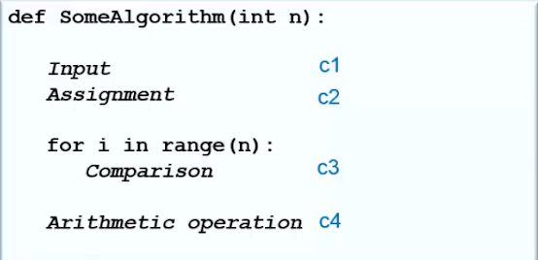
Running Time of an Algorithm
What is time complexity?
Anticipation of the increase in running time of an algorithm as its input size increases.
How to calculate?
Adding up complexities of individual operations
Example:
Complexity: c1+c2+(c3*n)+c4
Here, c1,c2,c3,c4 take O(1) time
Therefore complexity: O(1)+O(1)+O(1)*n+O(1)
O(n)
Notes:
Time complexity is the amount of time taken by an algorithm to run, as a function of the length of the input. It measures the time taken to execute each statement of code in an algorithm.

Slide 38
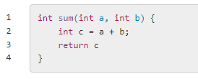
Example 1
The sum function has two statements.
The first statement (line 2) runs in constant time i.e. Θ(2) and second statement (line 3) also runs in constant time Θ(1).
These two statements are consecutive statements, so the total running time is Θ(2)+Θ(1)=Θ(2)

Slide 39
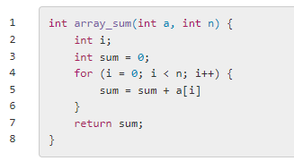
Example 2
Line 2 is a variable declaration. The cost is Θ(1)
Line 3 is a variable declaration and assignment. The cost is Θ(2)
Line 4 - 6 is a for loop that repeats n times. The body of the for loop requires Θ(1) to run. The total cost is Θ(n).
Line 7 is a return statement. The cost is Θ(1).
1, 2, 3, 4 are consecutive statements so the overall cost is Θ(n)

Slide 40
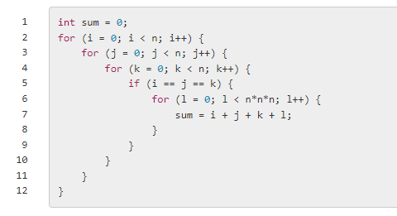
Example 3
Line 1 is a variable declaration and initialization. The cost is Θ(2)
Line 2 - 11 is a nested for loops. There are four for loops that repeat n times. After the third for loop in Line 4, there is a condition of i == j == k. This condition is true only n times. So the total cost of these loops is Θ(n³)+Θ(n⁴)=Θ(n⁴)
The overall cost is Θ(n⁴).

Slide 41
Insertion Sort
Insertion Algorithms: Steps on how it works:
If it is the first element, it is already sorted.
Pick the next element.
Compare with all the elements in sorted sub-list.
Shift all the the elements in sorted sub-list that is greater than the value to be sorted.
Insert the value.
Repeat until list is sorted.

Slide 42
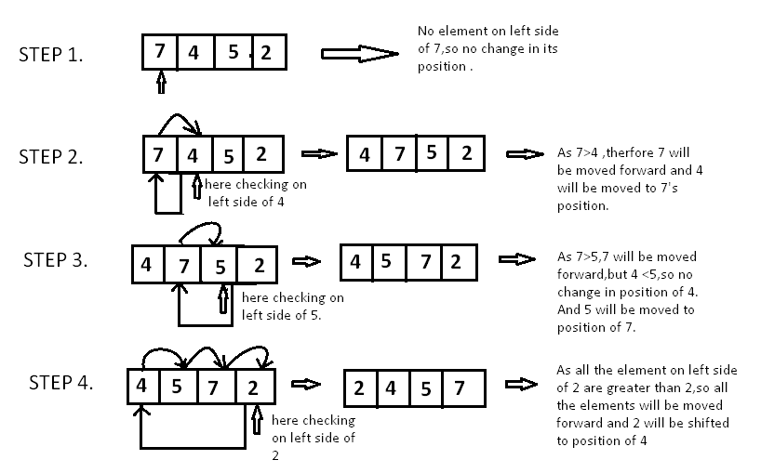

Slide 43
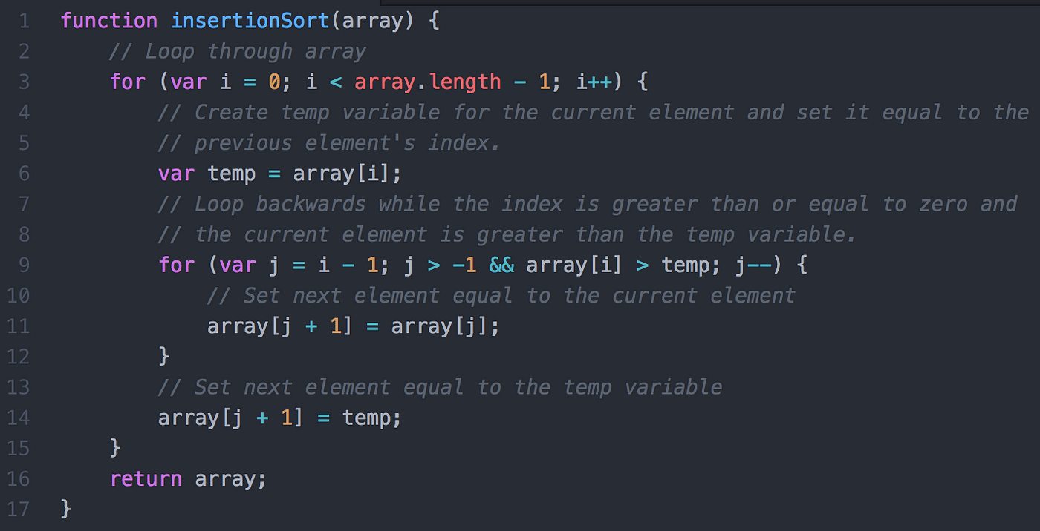

Slide 44
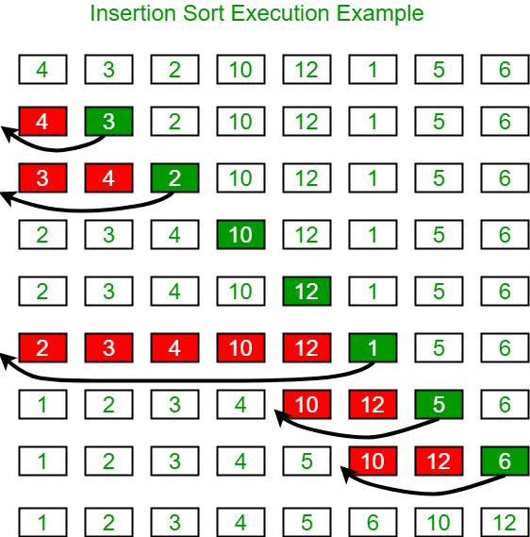
Example
3<4: Shift 3
2<4, 2<3: Shift 2
10>4: No shifting needed
10>12: No shifting needed
1<12, 1<10, 1<4, 1<3, 1<2: Shift 1
5<12, 5<10, 5>4: Shift 4
6<12, 6<10,6>5: Shift 6

Slide 45
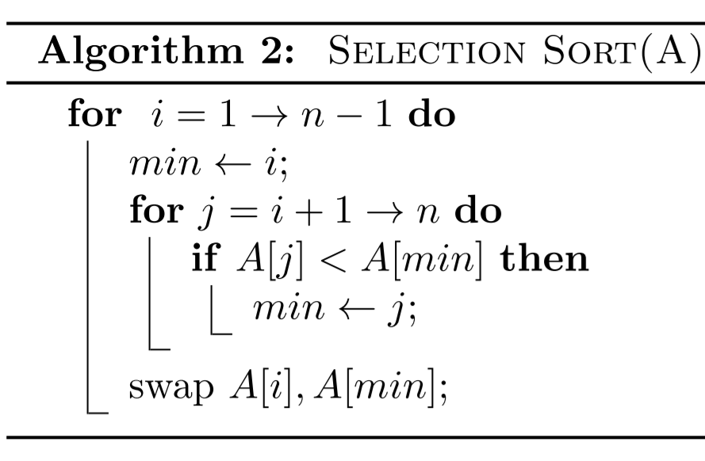
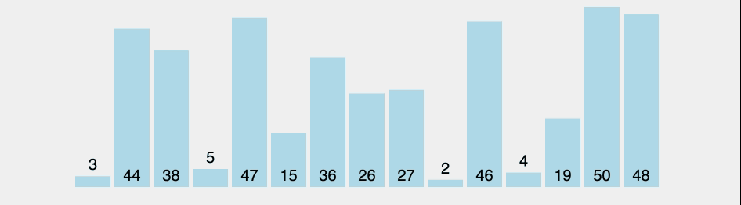
Selection Sort

Slide 46
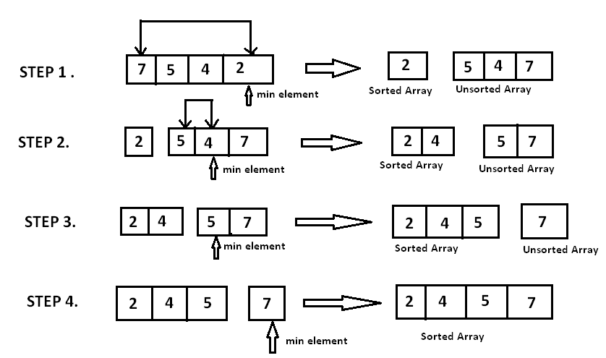
Example
i = 0; Minimum element = 2, index = 3. Swap arr[0] and arr[3]
i = 1; Minimum element = 4, index = 2. Swap arr[1] and arr[2]
i = 2; Minimum element = 5, index = 2. Swap arr[2] and arr[2]; Not needed

Slide 47
UPPER AND LOWER BOUND
The algorithm’s input normally consists of a list, a database, a variable, a graph, or some other type of data structure. In relation to its size, we want to know if there are any maximum or minimum time limits for an algorithm executed on a given input. We call these limits:
lower bound, the minimum guaranteed time
upper bound, the maximum guaranteed time

Slide 48
Recurrences and Running Time
An equation or inequality that describes a function in terms of its value on smaller inputs.
T(n) = T(n-1) + n
Recurrences arise when an algorithm contains recursive calls to itself
What is the actual running time of the algorithm?
Need to solve the recurrence
Find an explicit formula of the expression
Bound the recurrence by an expression that involves n

Slide 49
Example Recurrences
T(n) = T(n-1) + n Θ(n²)
Recursive algorithm that loops through the input to eliminate one item
T(n) = T(n/2) + c Θ(lgn)
Recursive algorithm that halves the input in one step
T(n) = T(n/2) + n Θ(n)
Recursive algorithm that halves the input but must examine every item in the input
T(n) = 2T(n/2) + 1 Θ(n)
Recursive algorithm that splits the input into 2 halves and does a constant amount of other work

Slide 50
Recurrent Algorithms BINARY-SEARCH
for an ordered array A, finds if x is in the array A[lo…hi]
Alg.: BINARY-SEARCH (A, lo, hi, x)
if (lo > hi)
return FALSE
mid ← ⎣(lo+hi)/2⎦
if x = A[mid]
return TRUE
if ( x < A[mid] )
BINARY-SEARCH (A, lo, mid-1, x)
if ( x > A[mid] )
BINARY-SEARCH (A, mid+1, hi, x)
1
2
3
4
5
6
7
8
2
3
5
7
9
10
11
12
mid
lo
hi

Slide 51
Example
A[8] = {1, 2, 3, 4, 5, 7, 9, 11}
lo = 1 hi = 8 x = 7
1
2
3
4
5
6
7
8
1
2
3
4
5
7
9
11
mid = 4, lo = 5, hi = 8
5
6
7
8
1
2
3
4
5
7
9
11
mid = 6, A[mid] = x Found!

Slide 52
Another Example
A[8] = {1, 2, 3, 4, 5, 7, 9, 11}
lo = 1 hi = 8 x = 6
1
2
3
4
5
6
7
8
1
2
3
4
5
7
9
11
mid = 4, lo = 5, hi = 8
low
high
1
2
3
4
5
7
9
11
mid = 6, A[6] = 7, lo = 5, hi = 5
low
high
1
2
3
4
5
7
9
11
mid = 5, A[5] = 5, lo = 6, hi = 5
NOT FOUND!
1
2
3
4
5
7
9
11
high
low

Slide 53
Analysis of BINARY-SEARCH
Alg.: BINARY-SEARCH (A, lo, hi, x)
if (lo > hi)
return FALSE
mid ← ⎣(lo+hi)/2⎦
if x = A[mid]
return TRUE
if ( x < A[mid] )
BINARY-SEARCH (A, lo, mid-1, x)
if ( x > A[mid] )
BINARY-SEARCH (A, mid+1, hi, x)
T(n) = c +
T(n) – running time for an array of size n
constant time: c₁
constant time: c₂
constant time: c₃
same problem of size n/2
same problem of size n/2
T(n/2)

Slide 54
Complexity Analysis of Binary Search
Since analysis starts with the middle element, in the best case, it’s possible that the middle element of the array itself is the target element.
Otherwise, the length of the array is halved.
In the following iterations, the size of the subarray is reduced using the result of the previous comparison.
Initial length of array =n
Iteration 1 - Length of array =n/2
Iteration 2 - Length of array =n/2²
Iteration k - Length of array =n/2^{k}

Slide 55
After k iterations, the size of the array becomes 1 (narrowed down to the first element or last element only).
Length of array n/2^{k}=1 => n=2^{k} Applying log function on both sides: => log₂​(n)=log₂​(2^{k}) => k∗log₂​2=k => k=log₂​(n)

Slide 56
Analysis of Time Complexity of Binary Search
Best Case Time Complexity of Binary Search
The best case scenario of Binary Search occurs when the target element is in the central index. In this situation, there is only one comparison. Therefore, the Best Case Time Complexity of Binary Search is O(1).

Slide 57
Average Case Time Complexity of Binary Search
The average case arises when the target element is present in some location other than the central index or extremities. The time complexity depends on the number of comparisons to reach the desired element.
Therefore, the overall Average Case Time Complexity of Binary Search is O(logn).

Slide 58
Worst Case Time Complexity of Binary Search
The worst-case scenario of Binary Search occurs when the target element is the **smallest element or the largest element ** of the sorted array.
In each iteration or recursive call, the search gets reduced to half of the array.
So for an array of size n, there are atmost log2n iterations or recursive calls.
Since the target element is present in the extremitites (first or last index), there are logn comparisons in total. Therefore, the Worst Case Time Complexity of Binary Search is O(logn).

Slide 59
Analysis of Space Complexity of Binary Search
In the case of the iterative approach, no extra space is used. Hence, the space complexity is O(1).
In the worst case, logn recursive calls are stacked in the memory.
i comparisons require i recursive calls to be stacked in memory.
Since average time complexity analysis has logn comparisons, the average memory will be O(logn).
Thus, in recursive implementation the overall space complexity will be O(logn).

Slide 60
Binary Search is used for finding the location of an element in a linear array.
It is a fast, efficient, and accurate search algorithm that can work on big and small datasets.
It works only on Sorted arrays.
Binary search uses the divide and conquer technique.
The time complexity for binary search is
Best Case - O(1)
Worst Case - O(logn)
Average Case -O(logn)
The space complexity for binary search is
recursive approach - O(logn)
iterative approach - O(1)
The equation T(n)= T(n/2)+1 is known as the recurrence relation for binary search.

Slide 61
Methods for Solving Recurrences
Iteration method
Substitution method
Recursion tree method
Master method

Slide 62
The Iteration Method
Convert the recurrence into a summation and try to bound it using known series
Iterate the recurrence until the initial condition is reached.
Use back-substitution to express the recurrence in terms of n and the initial (boundary) condition.

Slide 63
The Iteration Method
T(n) = c + T(n/2)
T(n) = c + T(n/2)
= c + c + T(n/4)
= c + c + c + T(n/8)
Assume n = 2^{k}
T(n) = c + c + … + c + T(1)
= clgn + T(1)
= Θ(lgn)
T(n/2) = c + T(n/4)
T(n/4) = c + T(n/8)
k times

Slide 64
Iteration Method – Example
T(n) = n + 2T(n/2)
T(n) = n + 2T(n/2)
= n + 2(n/2 + 2T(n/4))
= n + n + 4T(n/4)
= n + n + 4(n/4 + 2T(n/8))
= n + n + n + 8T(n/8)
… = in + 2^{i}T(n/2^{i})
= kn + 2^{k}T(1)
= nlgn + nT(1) = Θ(nlgn)
Assume: n = 2^{k}
T(n/2) = n/2 + 2T(n/4)

Slide 65
The substitution method
Guess a solution
Use induction to prove that the solution works

Slide 66
Substitution method
Guess a solution
T(n) = O(g(n))
Induction goal: apply the definition of the asymptotic notation
T(n) ≤ d g(n), for some d > 0 and n ≥ n₀
Induction hypothesis: T(k) ≤ d g(k) for all k < n
Prove the induction goal
Use the induction hypothesis to find some values of the constants d and n₀ for which the induction goal holds
(strong induction)

Slide 67
Example: Binary Search
T(n) = c + T(n/2)
Guess: T(n) = O(lgn)
Induction goal: T(n) ≤ d lgn, for some d and n ≥ n₀
Induction hypothesis: T(n/2) ≤ d lg(n/2)
Proof of induction goal:
T(n) = T(n/2) + c ≤ d lg(n/2) + c
= d lgn – d + c ≤ d lgn
if: – d + c ≤ 0, d ≥ c
Base case?

Slide 68
Example 2
T(n) = T(n-1) + n
Guess: T(n) = O(n²)
Induction goal: T(n) ≤ c n², for some c and n ≥ n₀
Induction hypothesis: T(n-1) ≤ c(n-1)² for all k < n
Proof of induction goal:
T(n) = T(n-1) + n ≤ c (n-1)² + n
= cn² – (2cn – c - n) ≤ cn²
if: 2cn – c – n ≥ 0 ⇔ c ≥ n/(2n-1) ⇔ c ≥ 1/(2 – 1/n)
For n ≥ 1 ⇒ 2 – 1/n ≥ 1 ⇒ any c ≥ 1 will work

Slide 69
Example 3
T(n) = 2T(n/2) + n
Guess: T(n) = O(nlgn)
Induction goal: T(n) ≤ cn lgn, for some c and n ≥ n₀
Induction hypothesis: T(n/2) ≤ cn/2 lg(n/2)
Proof of induction goal:
T(n) = 2T(n/2) + n ≤ 2c (n/2)lg(n/2) + n
= cn lgn – cn + n ≤ cn lgn
if: - cn + n ≤ 0 ⇒ c ≥ 1
Base case?

Slide 70
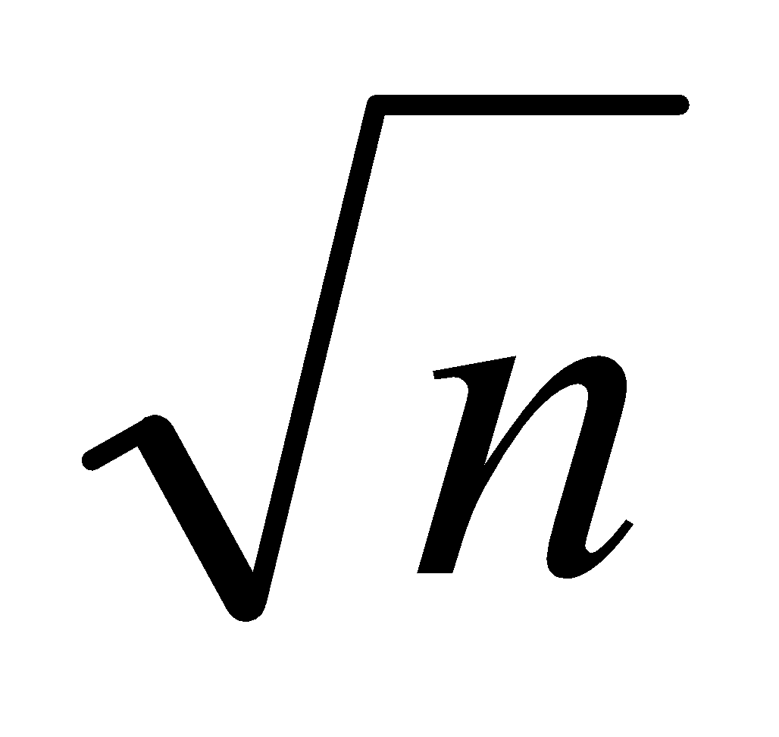
Changing variables
T(n) = 2T( ) + lgn
Rename: m = lgn ⇒ n = 2^{m}
T (2^{m}) = 2T(2^{m/2}) + m
Rename: S(m) = T(2^{m})
S(m) = 2S(m/2) + m ⇒ S(m) = O(mlgm) (demonstrated before)
T(n) = T(2^{m}) = S(m) = O(mlgm)=O(lgnlglgn)
Idea: transform the recurrence to one that you have seen before

Slide 71
The recursion-tree method
Convert the recurrence into a tree:
Each node represents the cost incurred at various levels of recursion
Sum up the costs of all levels
Used to “guess” a solution for the recurrence

Slide 72
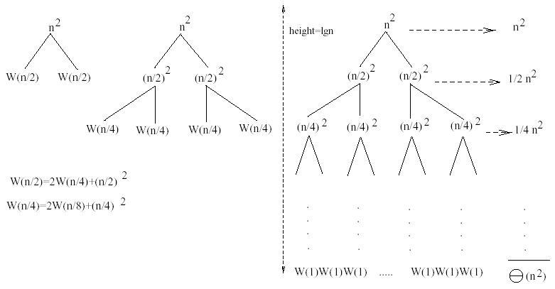
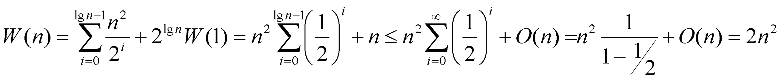
Example 1
W(n) = 2W(n/2) + n²
Subproblem size at level i is: n/2^{i}
Subproblem size hits 1 when 1 = n/2^{i} ⇒ i = lgn
Cost of the problem at level i = (n/2^{i})² No. of nodes at level i = 2^{i}
Total cost:
⇒ W(n) = O(n²)

Slide 73
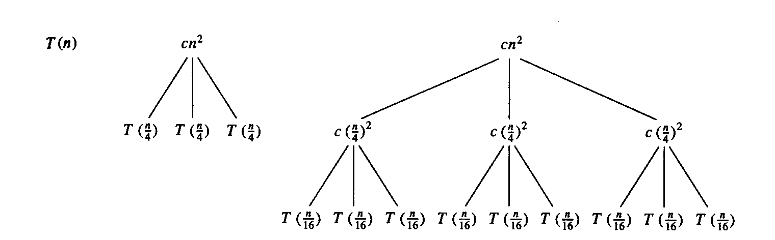
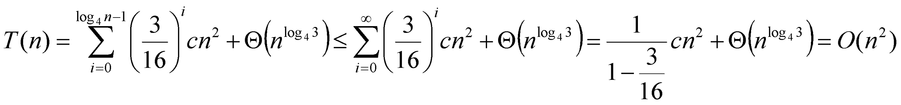
Example 2
E.g.: T(n) = 3T(n/4) + cn²
Subproblem size at level i is: n/4^{i}
Subproblem size hits 1 when 1 = n/4^{i} ⇒ i = log₄n
Cost of a node at level i = c(n/4^{i})²
Number of nodes at level i = 3^{i} ⇒ last level has 3^{log}₄^{n} = n^{log}₄³ nodes
Total cost:
⇒ T(n) = O(n²)

Slide 74
Example 2 - Substitution
T(n) = 3T(n/4) + cn²
Guess: T(n) = O(n²)
Induction goal: T(n) ≤ dn², for some d and n ≥ n₀
Induction hypothesis: T(n/4) ≤ d (n/4)²
Proof of induction goal:
T(n) = 3T(n/4) + cn²
≤ 3d (n/4)² + cn²
= (3/16) d n² + cn²
≤ d n² if: d ≥ (16/13)c
Therefore: T(n) = O(n²)

Slide 75
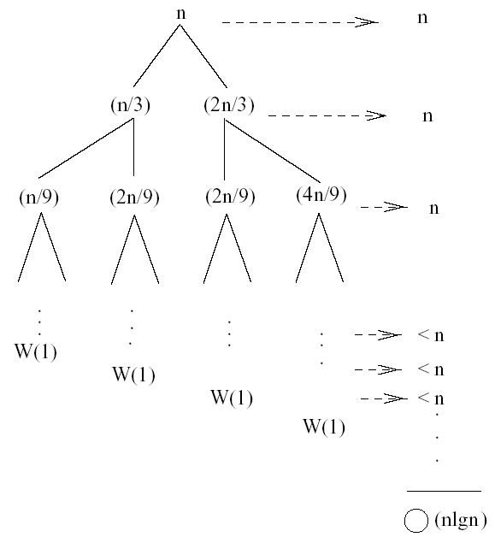
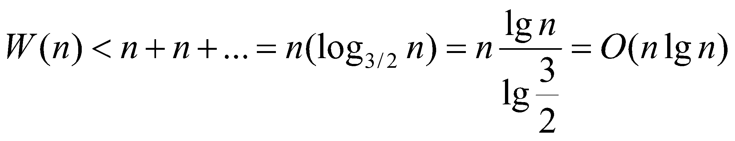
Example 3 (simpler proof)
W(n) = W(n/3) + W(2n/3) + n
The longest path from the root to a leaf is: n → (2/3)n → (2/3)² n → … → 1
Subproblem size hits 1 when 1 = (2/3)^{i}n ⇔ i=log_{3/2}n
Cost of the problem at level i = n
Total cost:
⇒ W(n) = O(nlgn)

Slide 76
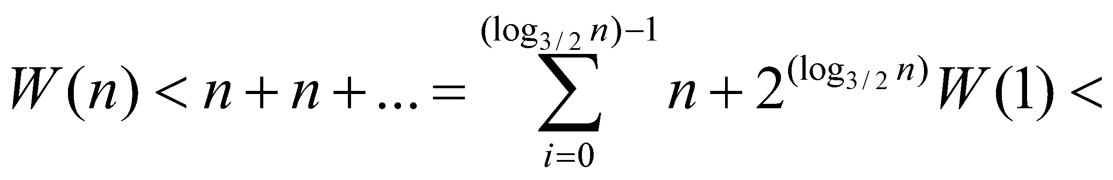
Example 3
W(n) = W(n/3) + W(2n/3) + n
The longest path from the root to a leaf is: n → (2/3)n → (2/3)² n → … → 1
Subproblem size hits 1 when 1 = (2/3)^{i}n ⇔ i=log_{3/2}n
Cost of the problem at level i = n
Total cost:
⇒ W(n) = O(nlgn)

Slide 77
Example 3 - Substitution
W(n) = W(n/3) + W(2n/3) + O(n)
Guess: W(n) = O(nlgn)
Induction goal: W(n) ≤ dnlgn, for some d and n ≥ n₀
Induction hypothesis: W(k) ≤ d klgk for any K < n (n/3, 2n/3)
Proof of induction goal:
Try it out as an exercise!!
T(n) = O(nlgn)

Slide 78
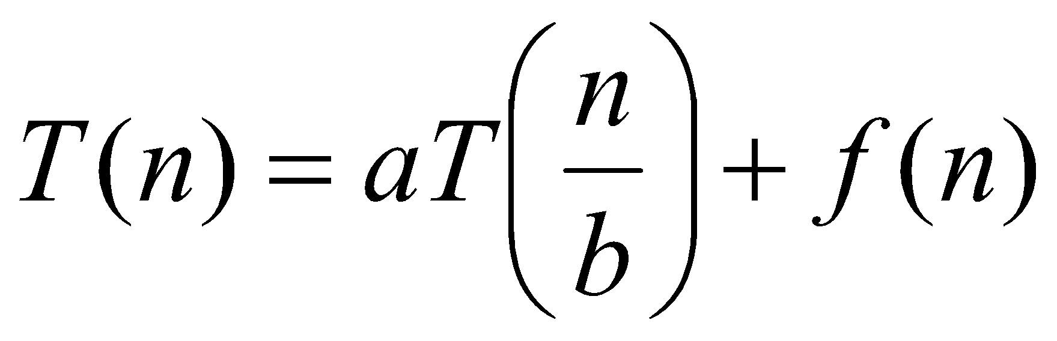
Master’s method
“Cookbook” for solving recurrences of the form:
where, a ≥ 1, b > 1, and f(n) > 0
Idea: compare f(n) with n^{log}_{b}ª
f(n) is asymptotically smaller or larger than n^{log}_{b}ª by a polynomial factor n^{ε}
f(n) is asymptotically equal with n^{log}_{b}ª

Slide 79
Master’s method
“Cookbook” for solving recurrences of the form:
where, a ≥ 1, b > 1, and f(n) > 0
Case 1: if f(n) = O(n^{log}_{b}^{a -ε}) for some ε > 0, then: T(n) = Θ(n^{log}_{b}ª)
Case 2: if f(n) = Θ(n^{log}_{b}ª), then: T(n) = Θ(n^{log}_{b}ª lgn)
Case 3: if f(n) = Ω(n^{log}_{b}^{a +ε}) for some ε > 0, and if
af(n/b) ≤ cf(n) for some c < 1 and all sufficiently large n, then:
T(n) = Θ(f(n))
regularity condition

Slide 80
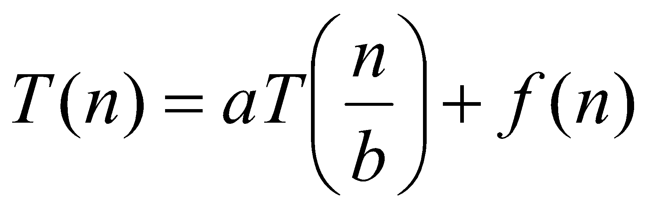
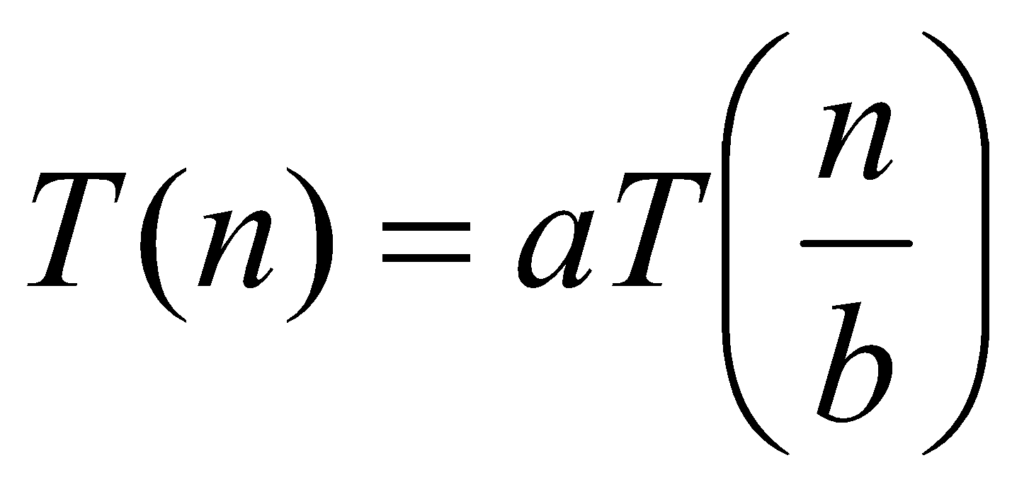
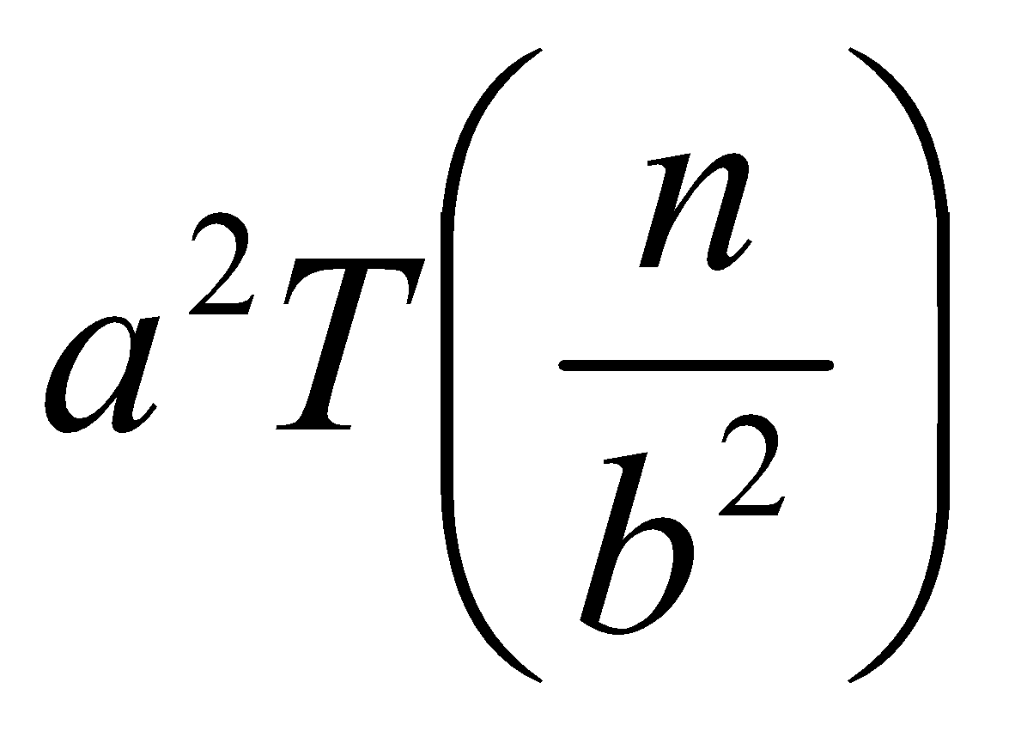
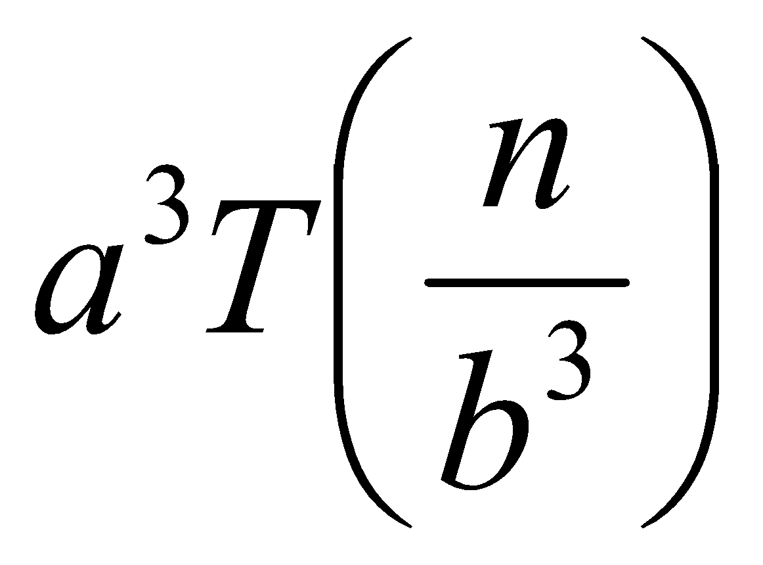
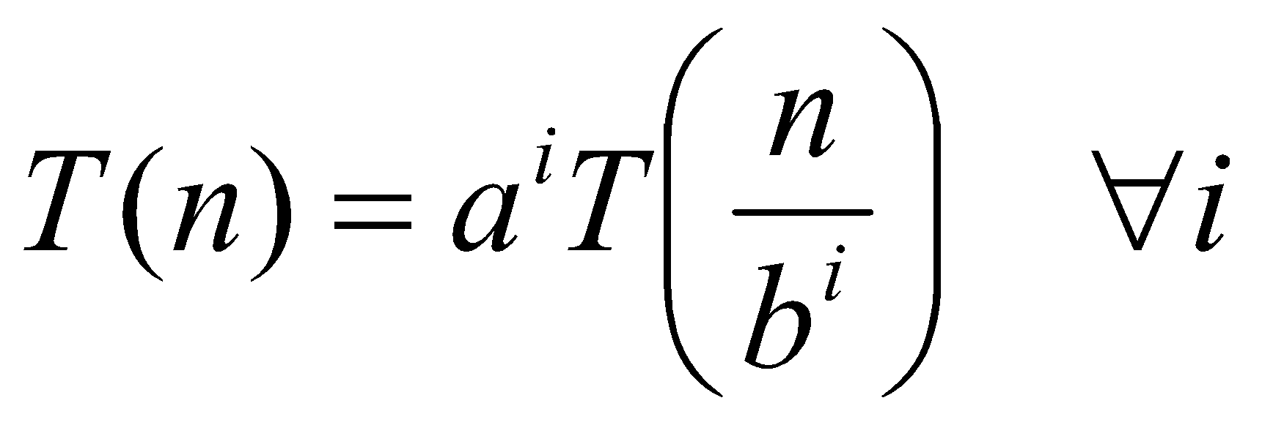
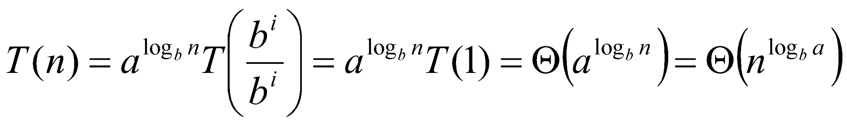
Why n^{log}_{b}ª?
Case 1:
If f(n) is dominated by n^{log}_{b}ª:
T(n) = Θ(n^{log}_{b}^{n})
Case 3:
If f(n) dominates n^{log}_{b}ª:
T(n) = Θ(f(n))
Case 2:
If f(n) = Θ(n^{log}_{b}ª):
T(n) = Θ(n^{log}_{b}ª logn)
Assume n = b^{k} ⇒ k = log_{b}n
At the end of iteration i = k:

Slide 81
Examples
T(n) = 2T(n/2) + n
a = 2, b = 2, log₂2 = 1
Compare n^{log}₂² with f(n) = n
⇒ f(n) = Θ(n) ⇒ Case 2
⇒ T(n) = Θ(nlgn)

Slide 82
Examples
T(n) = 2T(n/2) + n²
a = 2, b = 2, log₂2 = 1
Compare n with f(n) = n²
⇒ f(n) = Ω(n^{1+ε}) Case 3 ⇒ verify regularity cond.
a f(n/b) ≤ c f(n)
⇔ 2 n²/4 ≤ c n² ⇒ c = ½ is a solution (c<1)
⇒ T(n) = Θ(n²)

Slide 83
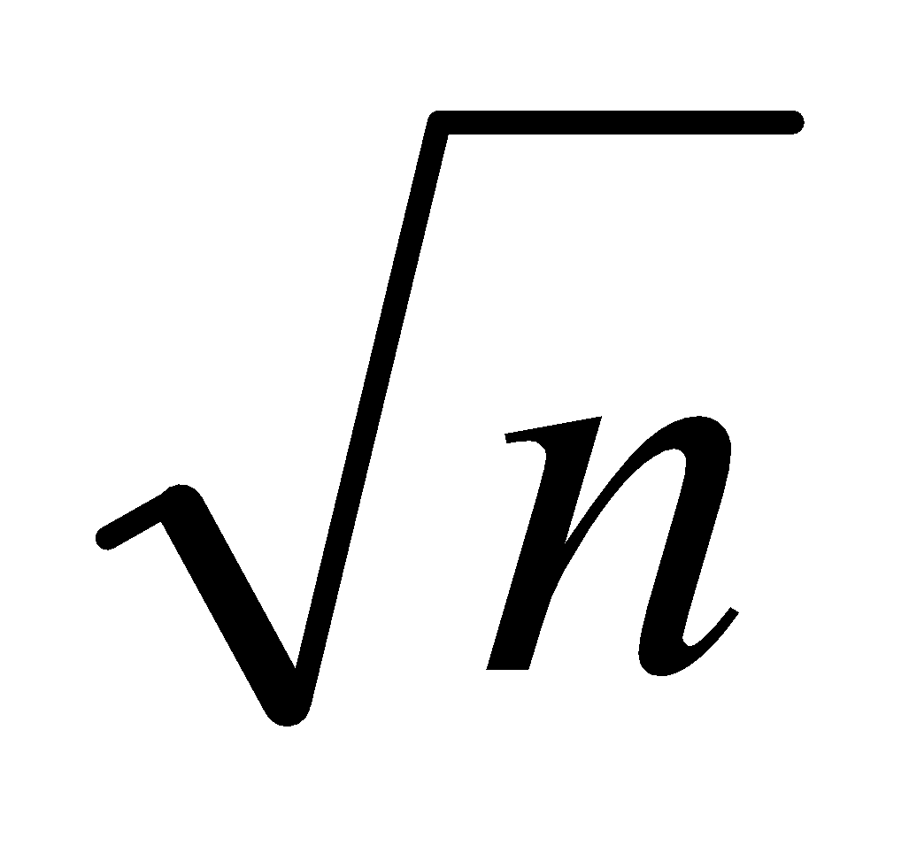
Examples (cont.)
T(n) = 2T(n/2) +
a = 2, b = 2, log₂2 = 1
Compare n with f(n) = n^{1/2}
⇒ f(n) = O(n^{1-ε}) Case 1
⇒ T(n) = Θ(n)

Slide 84
Examples
T(n) = 3T(n/4) + nlgn
a = 3, b = 4, log₄3 = 0.793
Compare n^{0.793} with f(n) = nlgn
f(n) = Ω(n^{log}₄^{3+ε}) Case 3
Check regularity condition:
3*(n/4)lg(n/4) ≤ (3/4)nlgn = c *f(n), c=3/4
⇒T(n) = Θ(nlgn)

Slide 85
Examples
T(n) = 2T(n/2) + nlgn
a = 2, b = 2, log₂2 = 1
Compare n with f(n) = nlgn
seems like case 3 should apply
f(n) must be polynomially larger by a factor of n^{ε}
In this case it is only larger by a factor of lgn

Slide 86
Matrix multiplication (Standard)
Let’s consider a simple 2 × 2 matrix multiplication
A=[1 2
3 4] and
B= [5 6
7 8]
Now each of the elements of product matrix AB can be calculated as follows:
AB11 = 1 × 5 + 2 ×7 = 19
AB12 = 1 × 6 + 2 × 8 = 22
AB21 = 3× 5 + 4 × 7 = 43
AB22 = 3 × 6 + 4 × 8 = 50
AB = [ 19 22
43 50]

Slide 87
Strassen’s Algorithm ( Matrix Multiplication)
1. Divide the Matrix
Given two n × n matrices A and B, we divide them into four equal-sized submatrices:
A= [A11 A12
A21 A22]
B= [B11 B12
B21 B22]
Each submatrix is of size n/2 × n/2.

Slide 88
2. Compute 7 Products
Instead of 8 multiplications (like in conventional matrix multiplication), Strassen’s method computes only 7 products:
M1​= (A11​+A22​) (B11​+B22​)
M2​= (A21​+A22​) B11
M3​= A11 ​(B12​−B22​)
M4​= A22​(B21​−B11​)
M5​= (A11​+A12​)B22​
M6​= (A21​−A11​)(B11​+B12​)
M7​= (A12​−A22​)(B21​+B22​)

Slide 89
3. Compute the Resulting Matrix
Using these 7 products, we reconstruct the result matrix C:
C11​= M1​+M4​−M5​+M7​
C12​= M3​+M5​
C21​= M2​+M4​
C22​= M1​−M2​+M3​+M6​

Slide 90
Example
Let’s take:
A= [1 2
3 4]
B= [5 6
7 8]

Slide 91
Step 1: Compute the 7 Multiplications
M1​= (1+4)×(5+8)=5×13=65
M2​= (3+4)×5=7×5=35
M3​= 1×(6−8)=1×(−2)=−2
M4​= 4×(7−5)=4×2=8
M5​= (1+2)×8=3×8=24
M6​= (3−1)×(5+6)=2×11=22
M7​= (2−4)×(7+8)=(−2)×15=−30

Slide 92
Step 2: Compute the Final Matrix C
C11​= M1​+M4​−M5​+M7​=65+8−24−30=19
C12​= M3​+M5​=−2+24=22
C21​= M2​+M4​=35+8=43
C22​= M1​−M2​+M3​+M6​=65−35−2+22=50
So, the final result is:
C=[19 22
43 50]

Slide 93
Matrix multiplication (Standard)
Let’s consider a simple 2 × 2 matrix multiplication
A=[3 7
4 9] and
B= [6 2
5 8]
Now each of the elements of product matrix AB can be calculated as follows:
AB11 = 3 × 6 + 7 ×5 = 53
AB12 = 3 × 2 + 7 × 8 = 62
AB21 = 4 × 6 + 9 × 5 = 69
AB22 = 4 × 2 + 9 × 8 = 80
AB = [ 53 62
69 80]

